Slide 1
Estate Planning and Administration
Date 1, 2020 Portland, Oregon
October 20, 2023

Slide 2
1. Overview
Basic Estate Planning Documents
What are they?
How are they executed?
How should they be maintained and safeguarded?
Basic Post-Mortem Administration
General tasks
Timelines to know.

Slide 3
2. Terminology Basics
Probate – Court supervised process of “proving” the Will. The process ensures that the correct Will is admitted to probate, interested parties receive notice and that necessary tasks are completed.
Personal Representative – The person appointed by the court to administer the estate through the probate process. Sometimes called executor or administrator.
Testate - Die leaving a Will.
Intestate - Die without leaving a Will.

Slide 4
2. Terminology Basics (cont’d)
Trust – A three party contract describing how property is to be held, managed and distributed. The three parties to the contract are:
Settlor – the party who creates the trust (sometimes called the Grantor, or Trustor)
Trustee – the party responsible for managing the trust
Beneficiary – the party who benefits from the Trust
Beneficiary Designation – A designation by owner of an asset designating who is to receive the asset at the owner’s death. Typical life insurance and retirement plan benefits.
Joint Tenancy with Right of Survivorship – Property owned by more than one person that automatically passes on the death of one owner to the remaining owner(s).

Slide 5
3. Estate Planning Document Basics
An estate plan should always include:
Will
Durable Powers of Attorney
Advance Directive (or equivalent healthcare documents)
An estate plan may, but does not always, include one or more trusts.

Slide 6
4. Will vs Trust
A Will does not become effective until the death of the testator (person making the Will). Until the death of the testator, no action is generally needed.
A trust becomes effective upon signing (and funding). Generally, a trust is effective during the Settlor’s lifetime and provides for distribution of assets upon the Settlor’s death. If assets are transferred to the trust, they can be managed for the benefit of the Settlor/beneficiary in the event that individual becomes incapacitated.

Slide 7
5. Other Planning Documents
DPOAs
Allow principal to name an agent to manage various financial decisions
Helpful if principal is unavailable or becomes incapacitated
Inexpensive way to plan for capacity issues
Relies on acceptance by third parties
Advance Directive
Allows individual to designate a healthcare representative and up to 2 alternates to make decisions on behalf if unable, and make end of life decisions known.
Positive → It’s a state form
Negative → It’s a state form

Slide 8
6. Execution and Safeguarding of Documents (cont’d)
Will
Signed by the testator in front of two witnesses
Both witnesses sign below testator’s signature
Witnesses sign an Attestation Affidavit attached to the Will and that affidavit is notarized.
*ORS 112.235 lists formalities
*ORS 112.238 may save you if formalities are not followed, but don’t count on it

Slide 9
6. Execution and Safeguarding of Documents (cont’d)
DPOAs
Signed by the principal
Recommend having principal’s signature notarized.

Slide 10
6. Execution and Safeguarding of Documents (cont’d)
Advance Directive
Signed by the client in front of either:
2 Witnesses (who sign and complete witness details) OR
Notary (who signs, stamps and completes notary details)
Signed by each healthcare representative

Slide 11
6. Execution and Safeguarding of Documents (cont’d)
Trust
Signed by Settlor(s) – recommend signatures be notarized
Signed by Trustee(s) – recommend signatures be notarized
Trust related documents: Certification of Trust and trust funding documents (i.e. – deeds, business entity assignments, bills of sale, all-inclusive assignments)

Slide 12
7. Post-Mortem Administration Generally
Gather details on the decedent (death certificate)
Get basic asset inventory to evaluate whether probate is needed
Start evaluating creditors
Review documents (and family tree) to get a sense of interested persons

Slide 13
8. Probate Administration
Initiating the Probate:
Petition for Probate
Testate or intestate
PR qualification and bonding
Decedent details and venue
Basic assets subject to probate
Interested persons required to be disclosed
Proposed Limited Judgment
Admitting Will to probate (if there is one)
Appointing PR
Addressing bond and issuance of Letters
*Original Will must be sent to court.

Slide 14
8. Probate Administration (cont’d)
Notices: Once the PR is appointed they are responsible for various notices:
Heirs and Devisees receive notice
State Agencies
Publication of Notice

Slide 15
8. Probate Administration (cont’d)
Creditors and Claims: ORS Chapter 115
Provide Notice of Right to Asset Claim to any likely creditors
Promptly calendar disallowance deadline if any claim is received
Any Notice of Disallowance must state the reason for the disallowance

Slide 16
8. Probate Administration (cont’d)
Reporting to the Court
Inventory
Proof of Notices
Statement of Compliance
Annual Accountings
*Note some counties require PR to complete a fiduciary training class, and proof of completion must be filed

Slide 17
8. Probate Administration (cont’d)
Closing the Probate
Final Accounting or Statement in Lieu includes a petition for approval of fees and distribution:
PR fee – PR cannot be paid without prior court approval
Attorney fees – attorney cannot be paid without prior court approval
If estate is insolvent, ORS 115.125 contains order of priority for payment. If insolvent then accounting should address which claims will be satisfied. Any creditor whose approved claim will not be paid in full must receive notice.
Seek approval of any other action deemed necessary
Seek approval for distribution of assets among beneficiaries – no distributions can be made to a beneficiary without prior court approval.
Once distributions are done, receipts should be filed, the bond (if any) exonerated, the PR discharged and released and the estate formally closed by a Supplemental Judgment.

Slide 18
9. Trust Administration
Trust administrations are much less formal than probate.
However, may of the same activities are required.
Generally, trust administrations proceed much more quickly because there is not court supervision and the trustee can make distributions when it determines they are appropriate.
Beneficiaries are entitled to certain notices and information about a trust. See ORS 130.710 with basic details and ORS 130.733.

Slide 19
9. Trust Administration (cont’d)
Trusts can take advantage of a creditor claim process similar to that for probate. See ORS 130.350 et seq.
Inventory assets and plans for distributions.
Consider use of Distribution Agreement
Determine whether a trust accounting is required or advisable
Receipts for distribution

Slide 20
10. Taxes and Other Fun Stuff
Consider Estate Taxes: Need to gather details on all assets including in taxable estate.
Oregon Estate Tax Return:
Required when Taxable Estate is $1,000,000 or more and decedent is a resident of Oregon, or there is Oregon property.
Due on anniversary of decedent’s death unless a federal return is required, then due 9 months after date of death.
6 month extension of time to file is available upon filing of extension (automatic), but extensions of time to pay are not automatic.

Slide 21
10. Taxes and Other Fun Stuff
Consider Estate Taxes (cont’d)
Federal Estate Tax Return:
Required when Taxable Estate is over the decedent’s estate tax exemption. The exemption is $12,920,000.
Available when there is a surviving spouse to take advantage of portability.
Estate Tax return in another state: If the decedent is a resident of another state or owns property in another state, an estate tax return may be required in that state.

Slide 22
10. Taxes and Other Fun Stuff (cont’d)
Consider Income Taxes:
Final personal income tax return needs to be completed (generally if there is a surviving spouse the final return can be filed as a joint return).
The estate/trust are separate taxpayers.
Estate’s tax year: Day after date of death to the last day of the month immediately before the anniversary of the death. Going forward the estate keeps the same tax year end.
Trusts use a calendar year
Unless a 645 election is made
CPAs are helpful as fiduciary income tax returns are complex and result in issuance of K-1s for beneficiaries when distributions are done during a tax year.

Slide 23
10. Taxes and Other Fun Stuff
Roadmap and/or Administration To Do List
Calendar deadlines and important dates

Slide 24
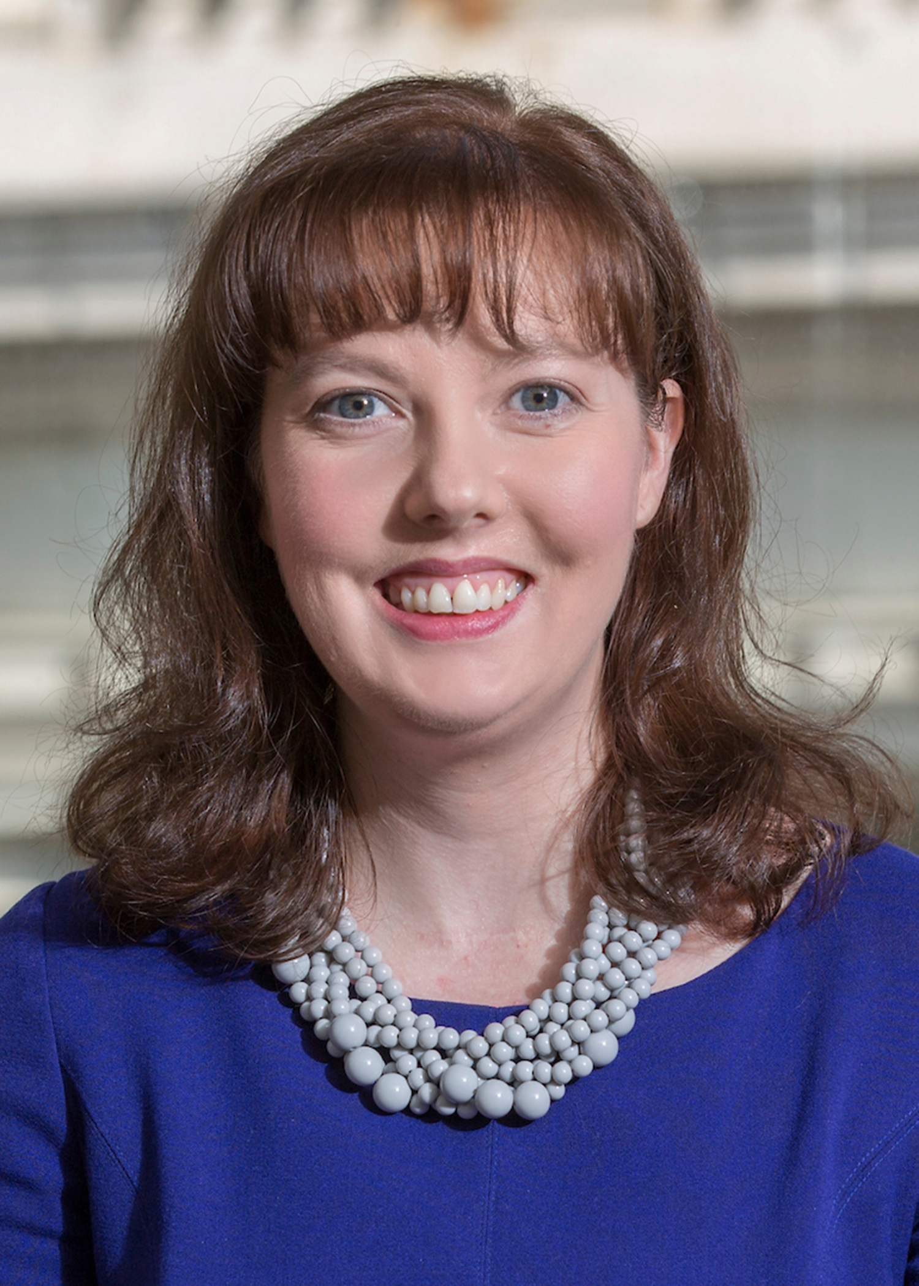
Melissa F. Busley
Dunn Carney LLP
mbusley@dunncarney.com
503-417-5460

